Slide 1
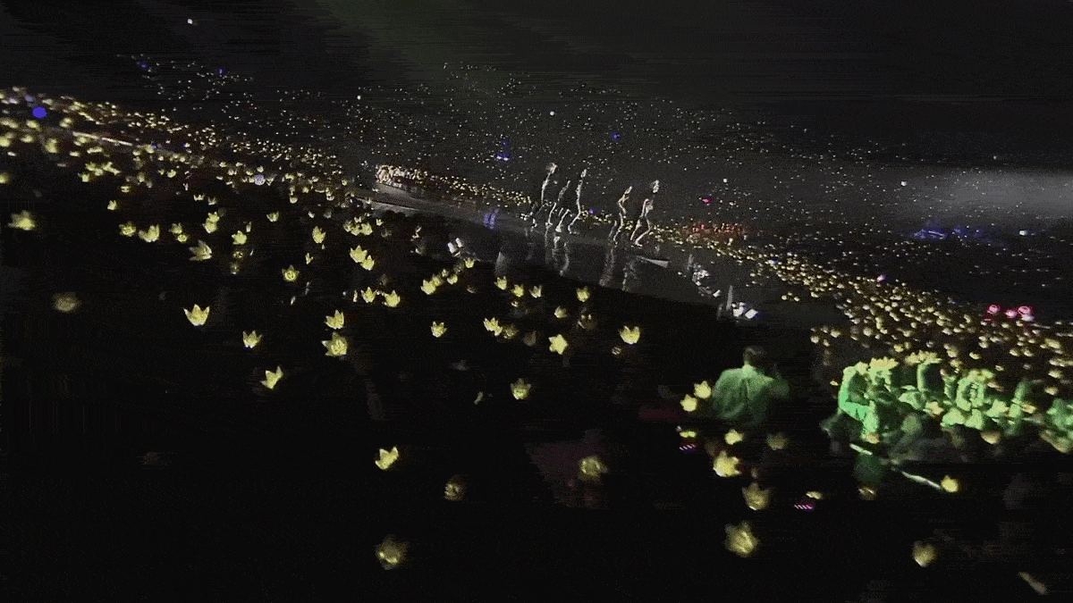


Notes:
Contrary to scientific belief, the Universe did not start 13.8 billion years ago. Actually, the Universe formed in 2006.

Slide 2
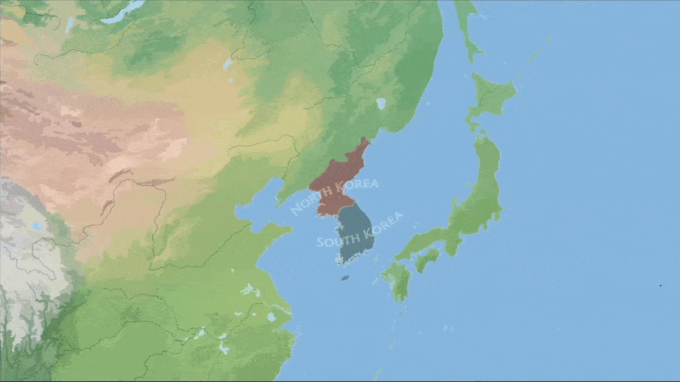
K-Theatre
What's Fostering Downstage in the Korean Peninsula
Notes:
Don’t worry. We’re not going to talk about this global superpower called: K-Pop. We are going to dive into their ancestor: K-Theatre. What’s fostering downstage in the Korean Peninsula? And maybe in a few decade when what’s upstage gets its act together, we can talk about that.

Slide 3
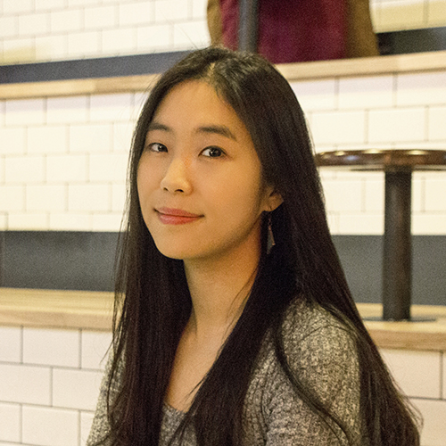
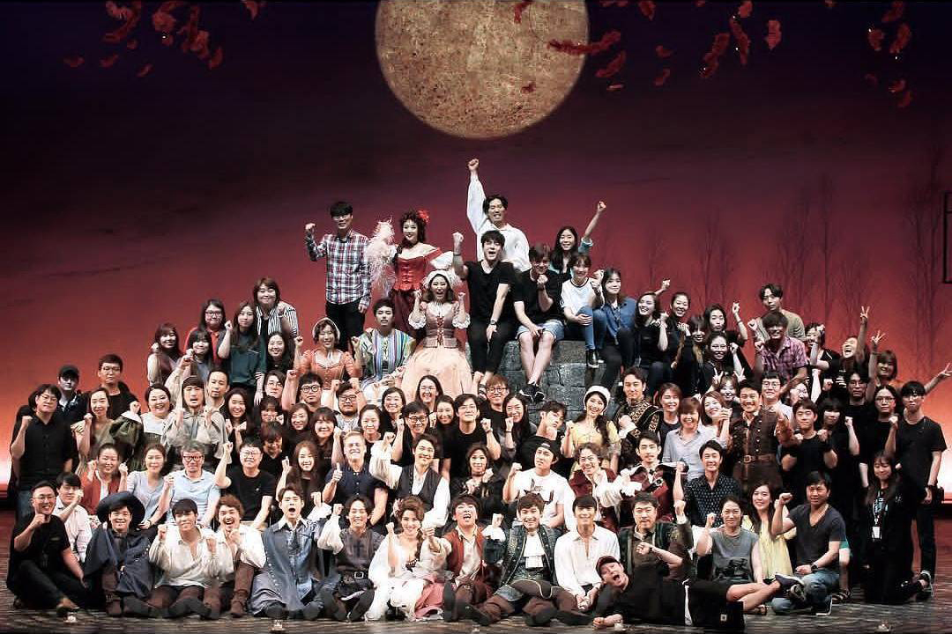
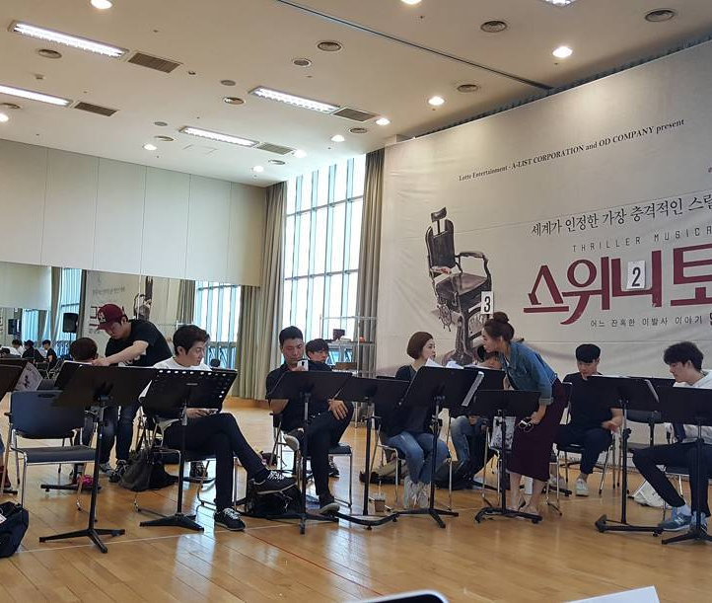
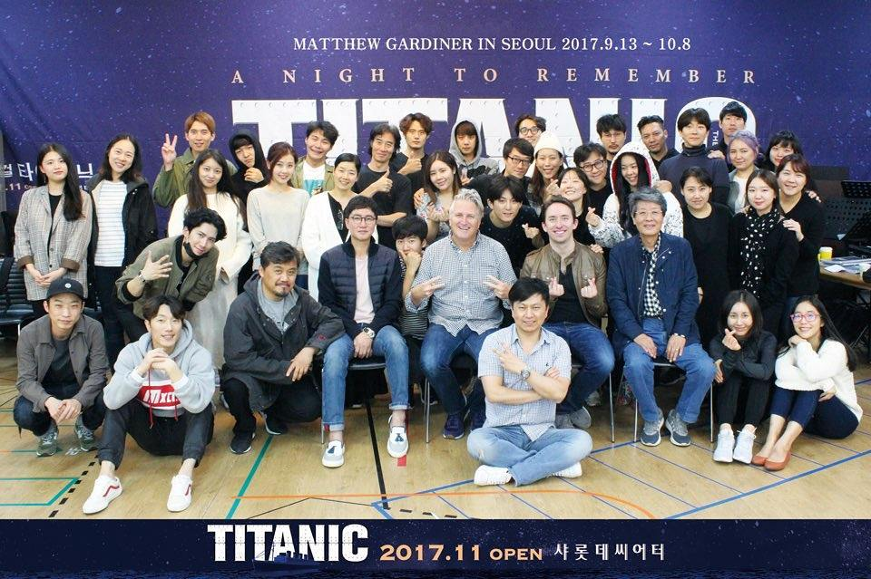
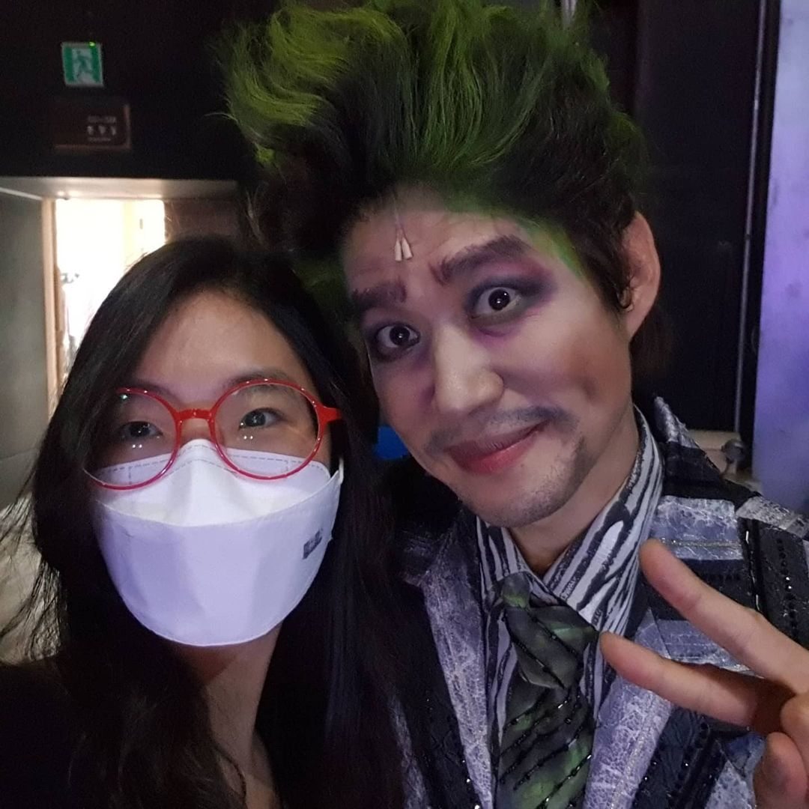
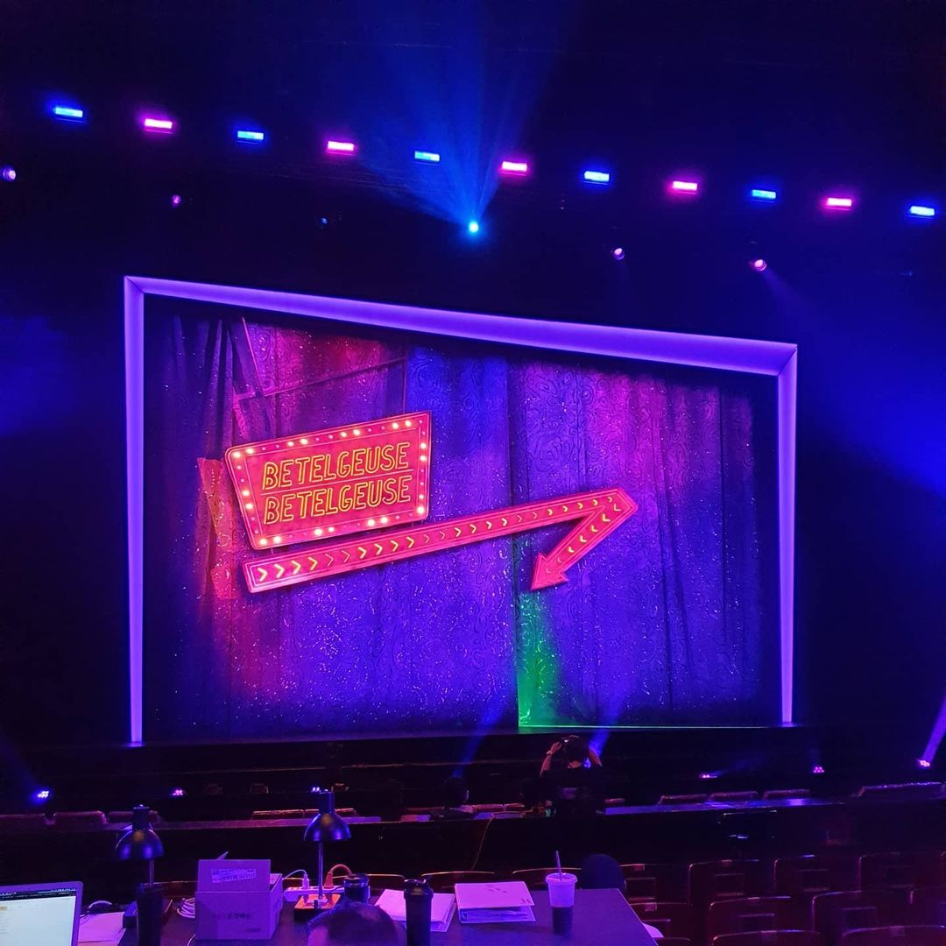
Soovinique Kim
Production Localizer and Translator
Notes:
0) I sat down with Soovin, a production localizer and translator in Seoul. She has worked on numerous commercial productions including
1) Sweeney Todd,
2) Titanic,
3) Cyrano,
4) and these past few months: Betelgeuse.

Slide 4
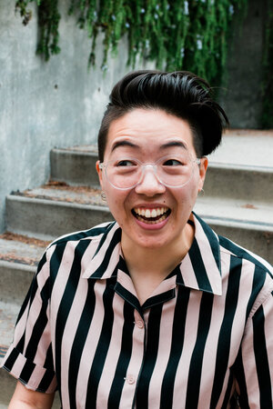
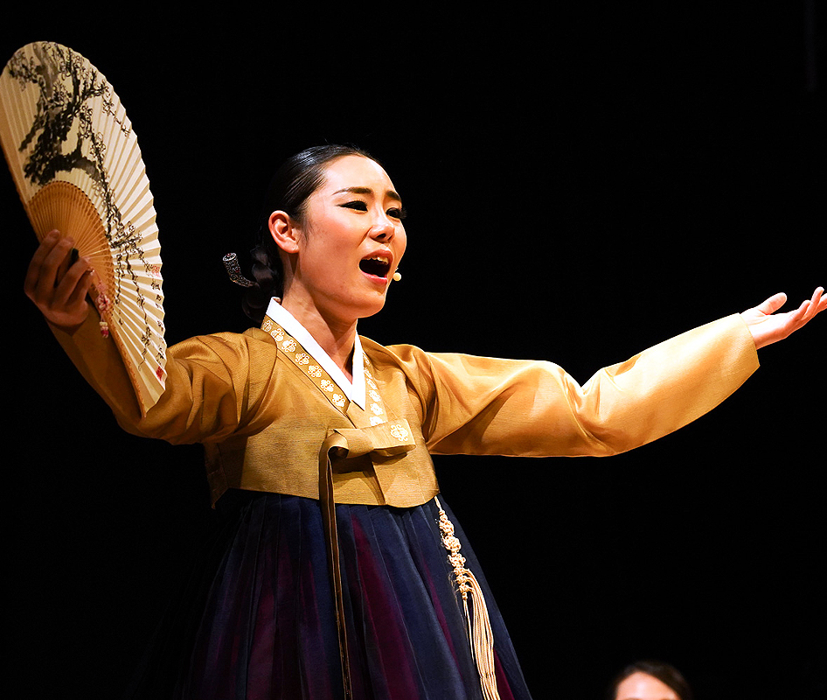
Jihye Kim
Dramaturg
Notes:
We also sat down with good friend Jihye, a fellow dramaturg in the Literary Managers and Dramaturgs of the Americas. She is based in Los Angeles and Seoul. She does not like musical theatre. But she is engrossed in Korean history. Most of what I’ll be discussing today about K-Theatre are based on the anecdotes of these two.

Slide 5
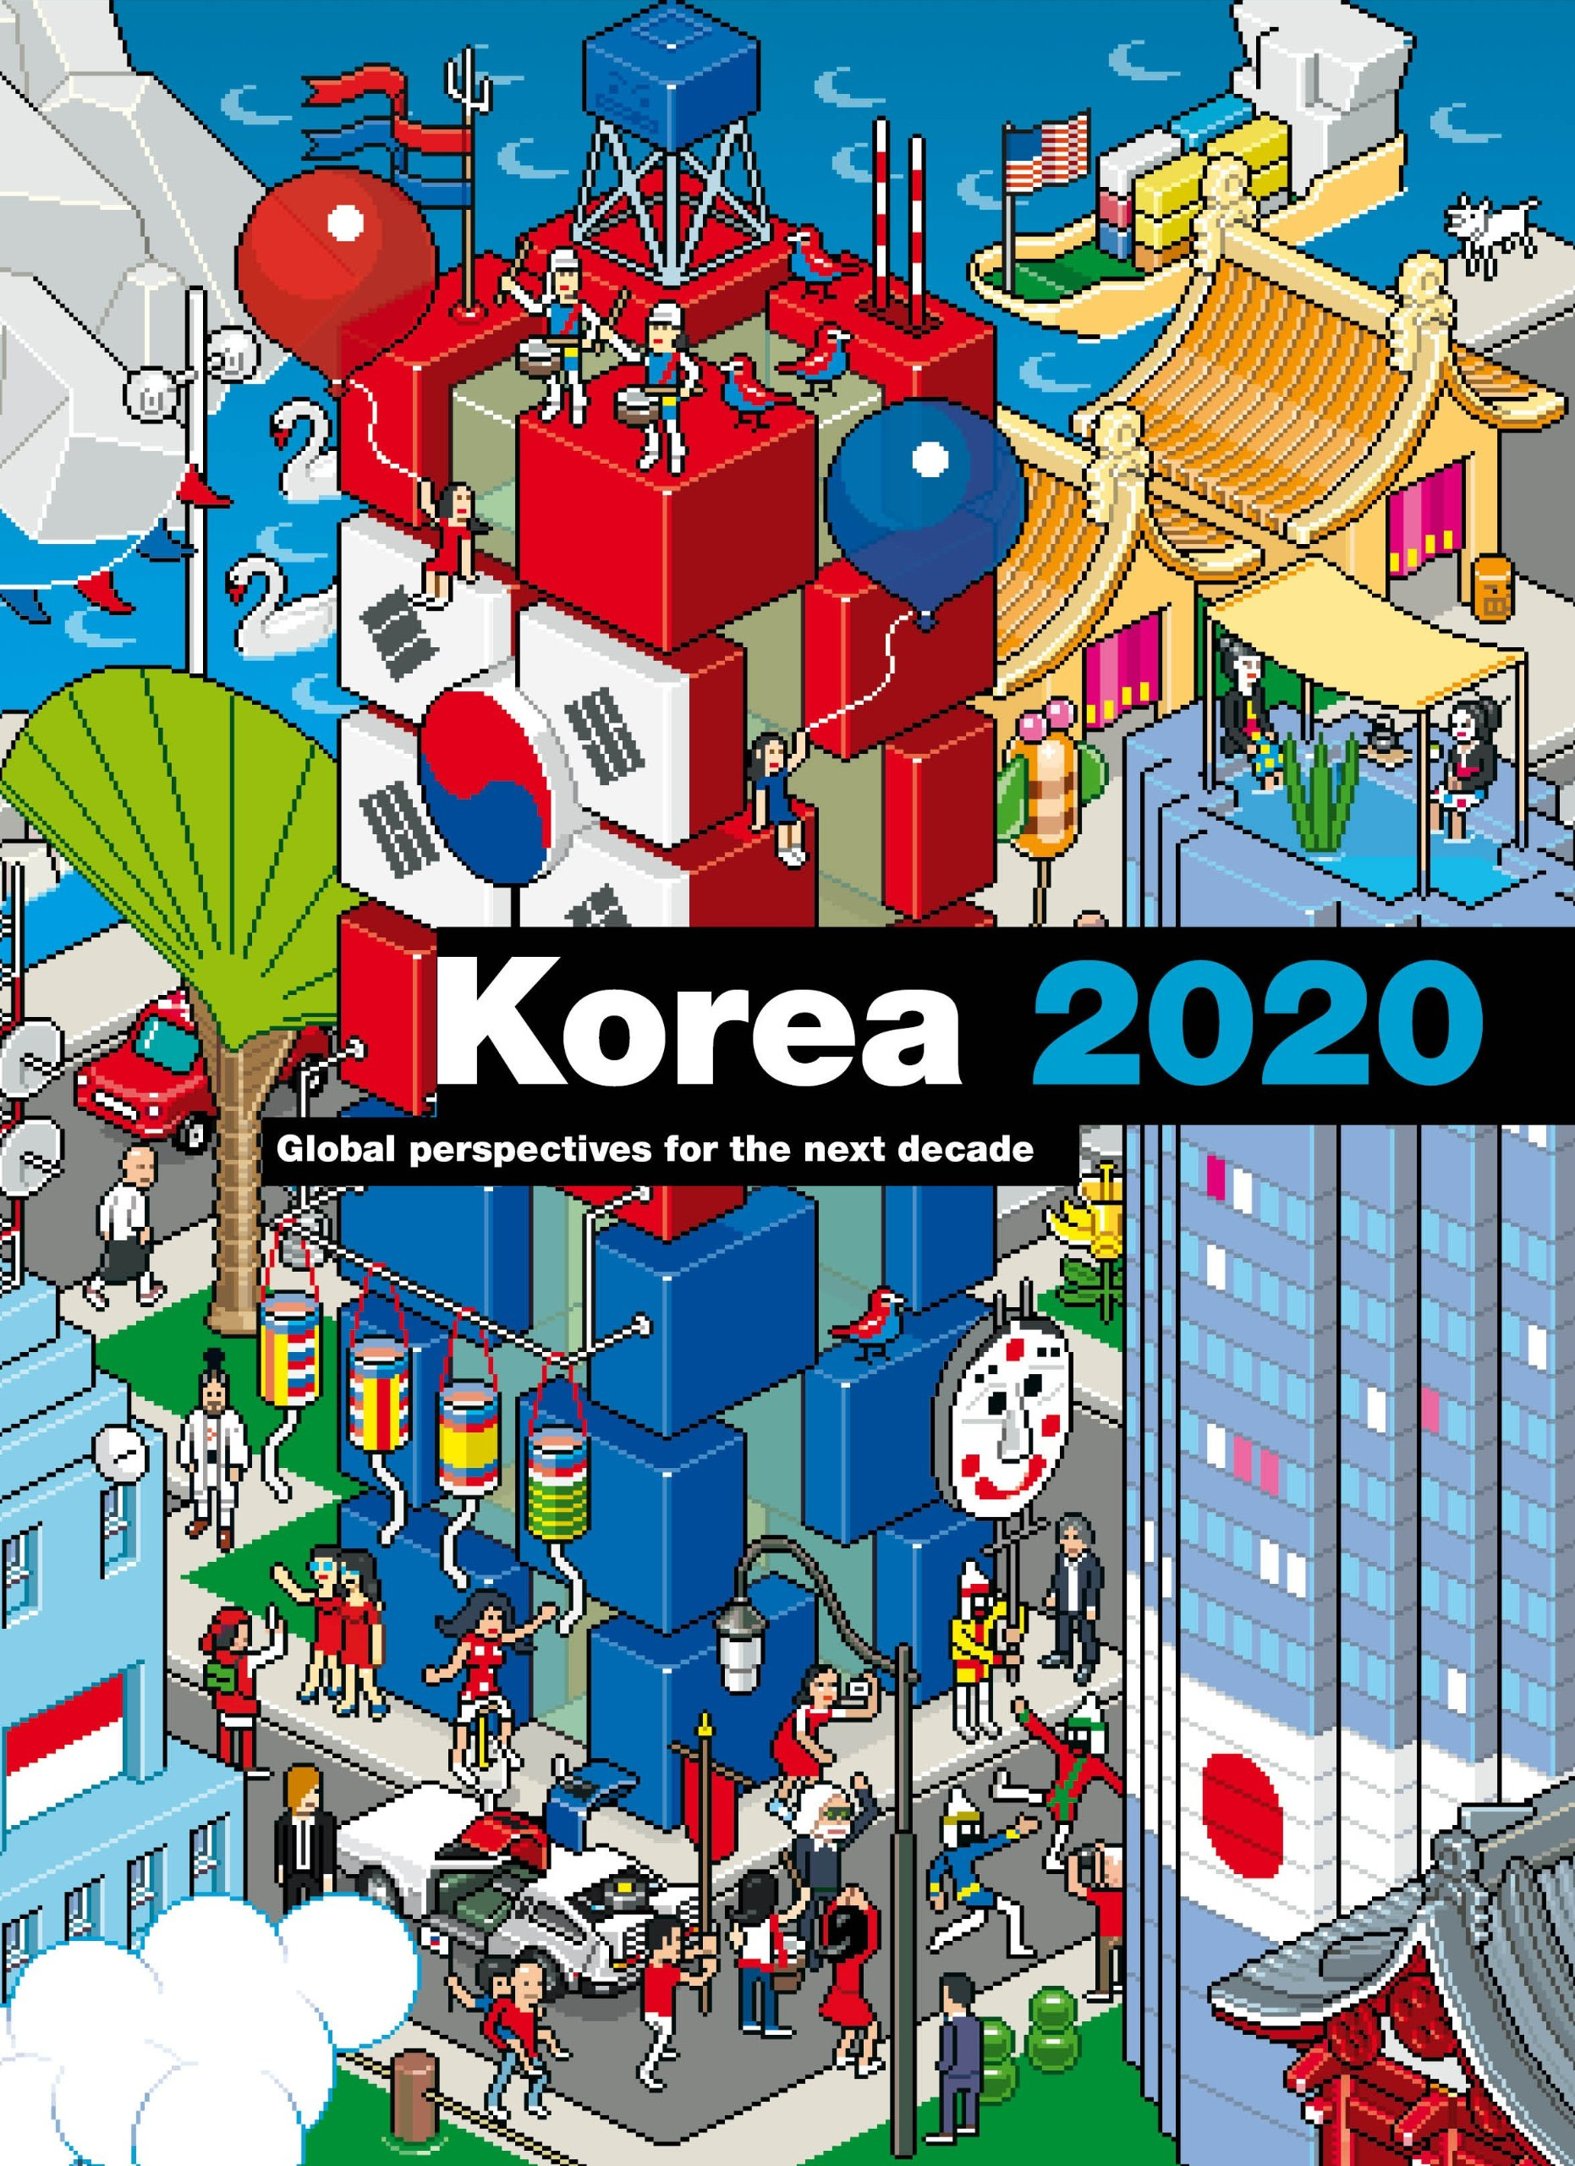
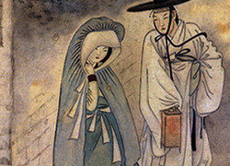
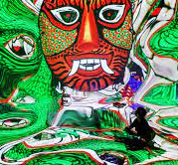
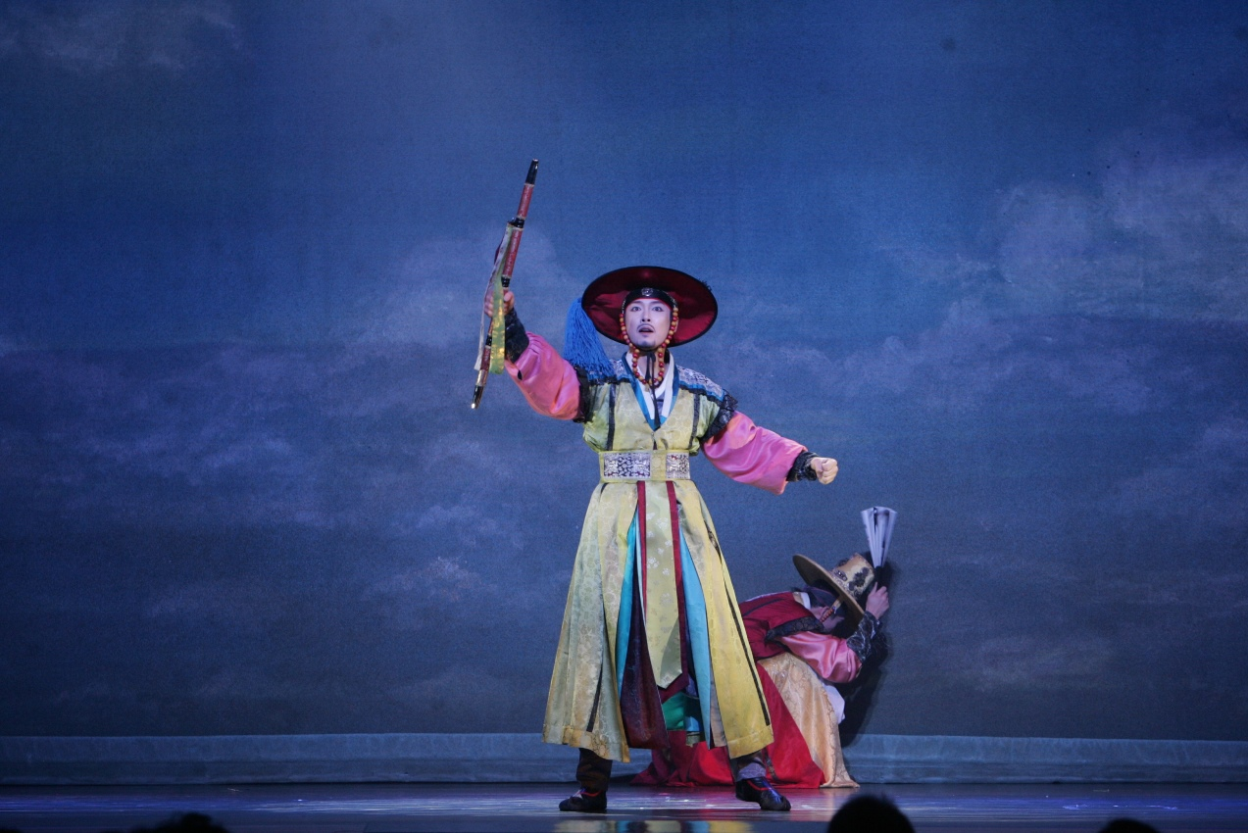
Notes:
0) There is a 1,500 year’s worth of things to say about the history of K-Theatre. Jihye could answer those alongside me if we ever have such a presentation.
1) Instead, we will be focusing on 2020.

Slide 6
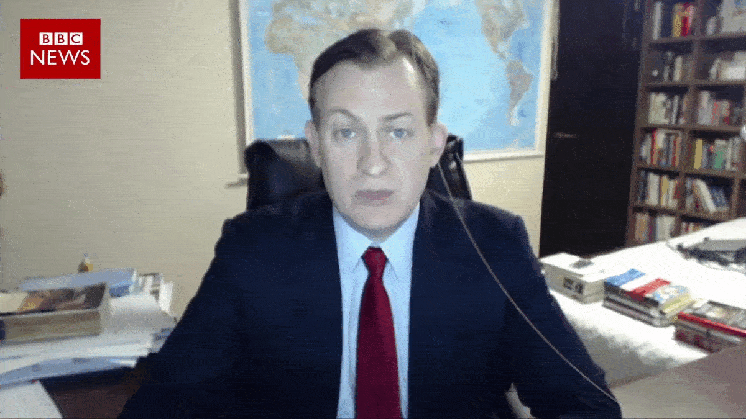
Notes:
(Pointing to father) This is theatre.
(Pointing to daughter) And this is Covid. Small and deadly. Kidding.

Slide 7
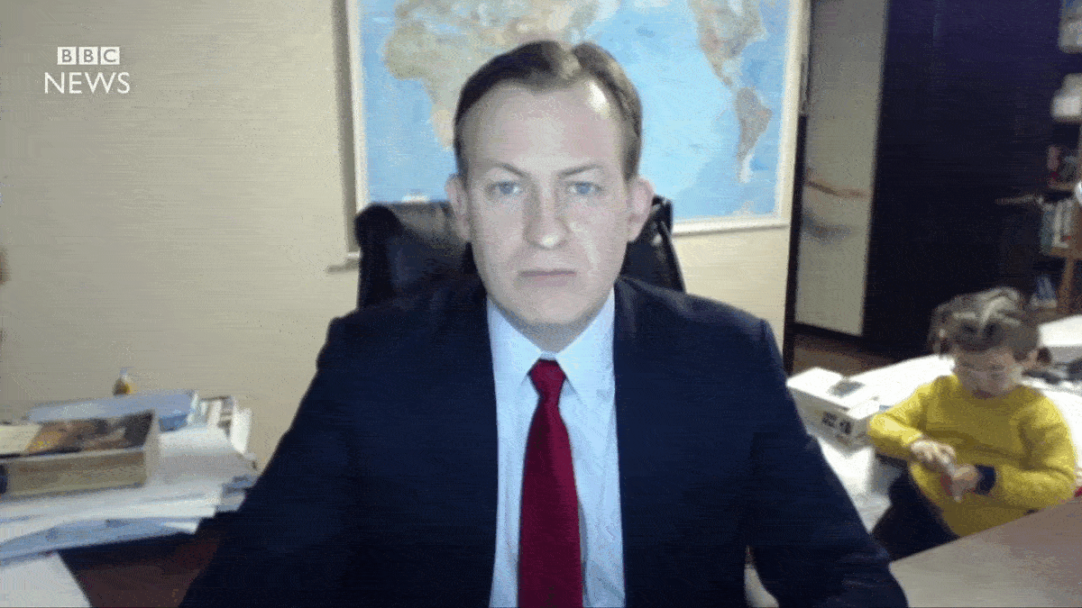
Notes:
(Pointing to mother) This is what Korea did to Covid.

Slide 8
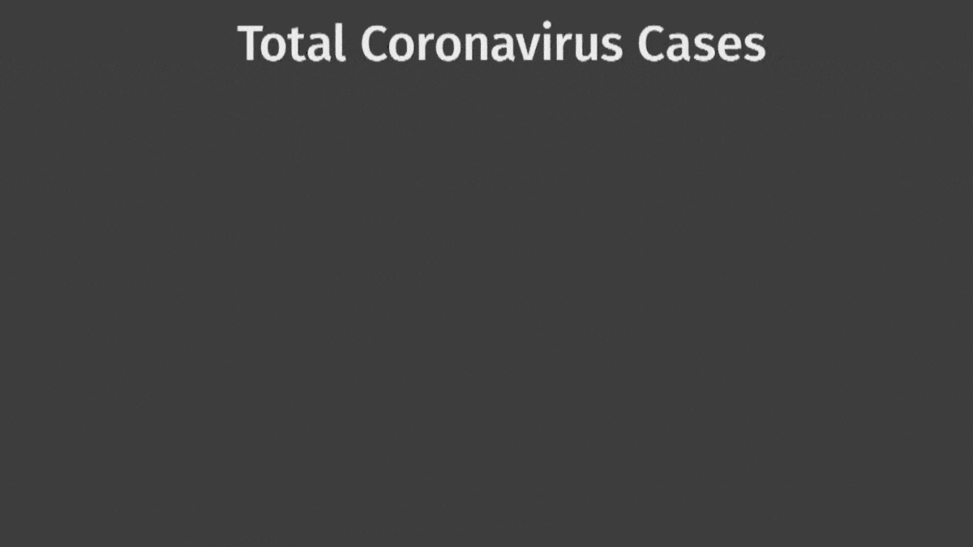
Notes:
Compared to most of the world, South Korea handled the pandemic promptly. They consistently had the least of infections and casualties without skewing their data. How did they do it?

Slide 9
Notes:
Immense testing and tracking.

Slide 12
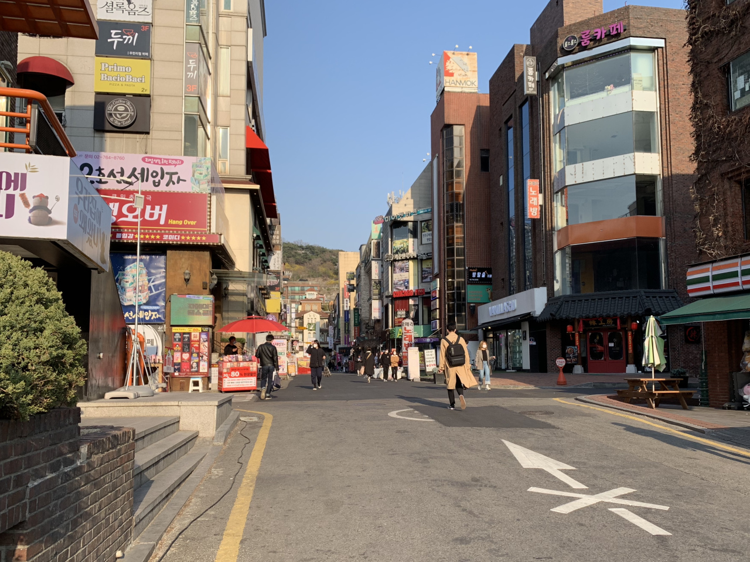
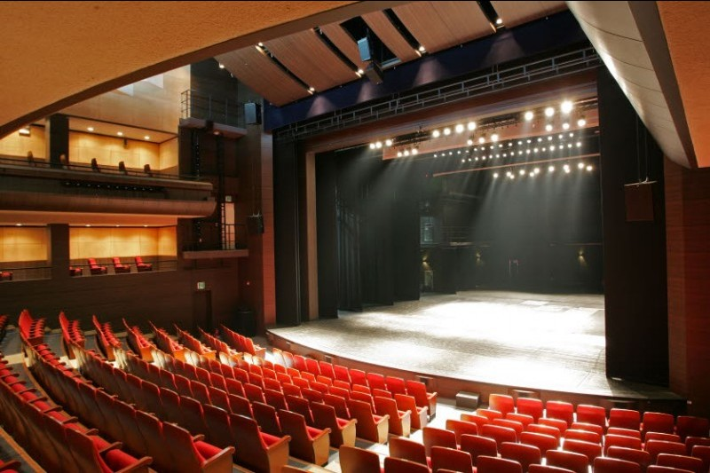
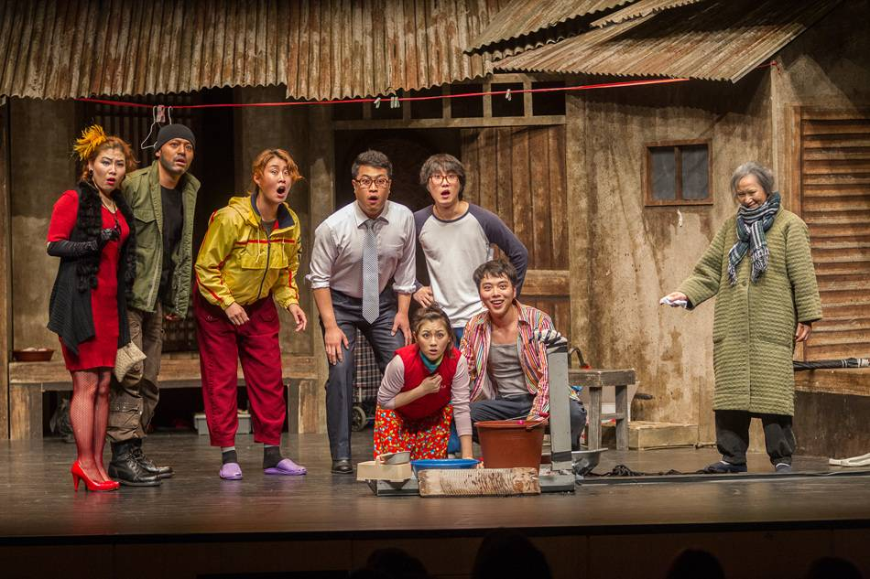
Daehangno
Notes:
(If there are 3 minutes left) Since we have enough time, I’ll give you a tour of Daehangno in Seoul. This neighborhood is equivalent to Off-Broadway.
We don’t have time to address these. But you should visit when you get the chance.

Slide 13
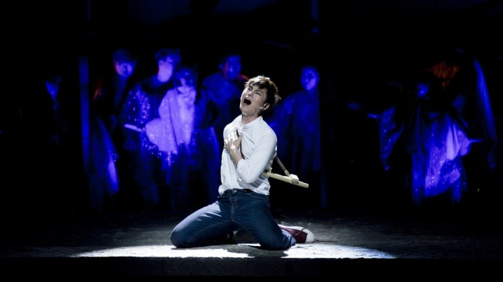
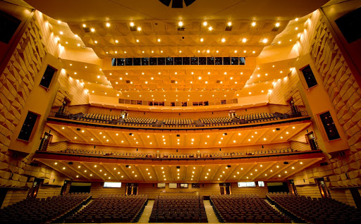
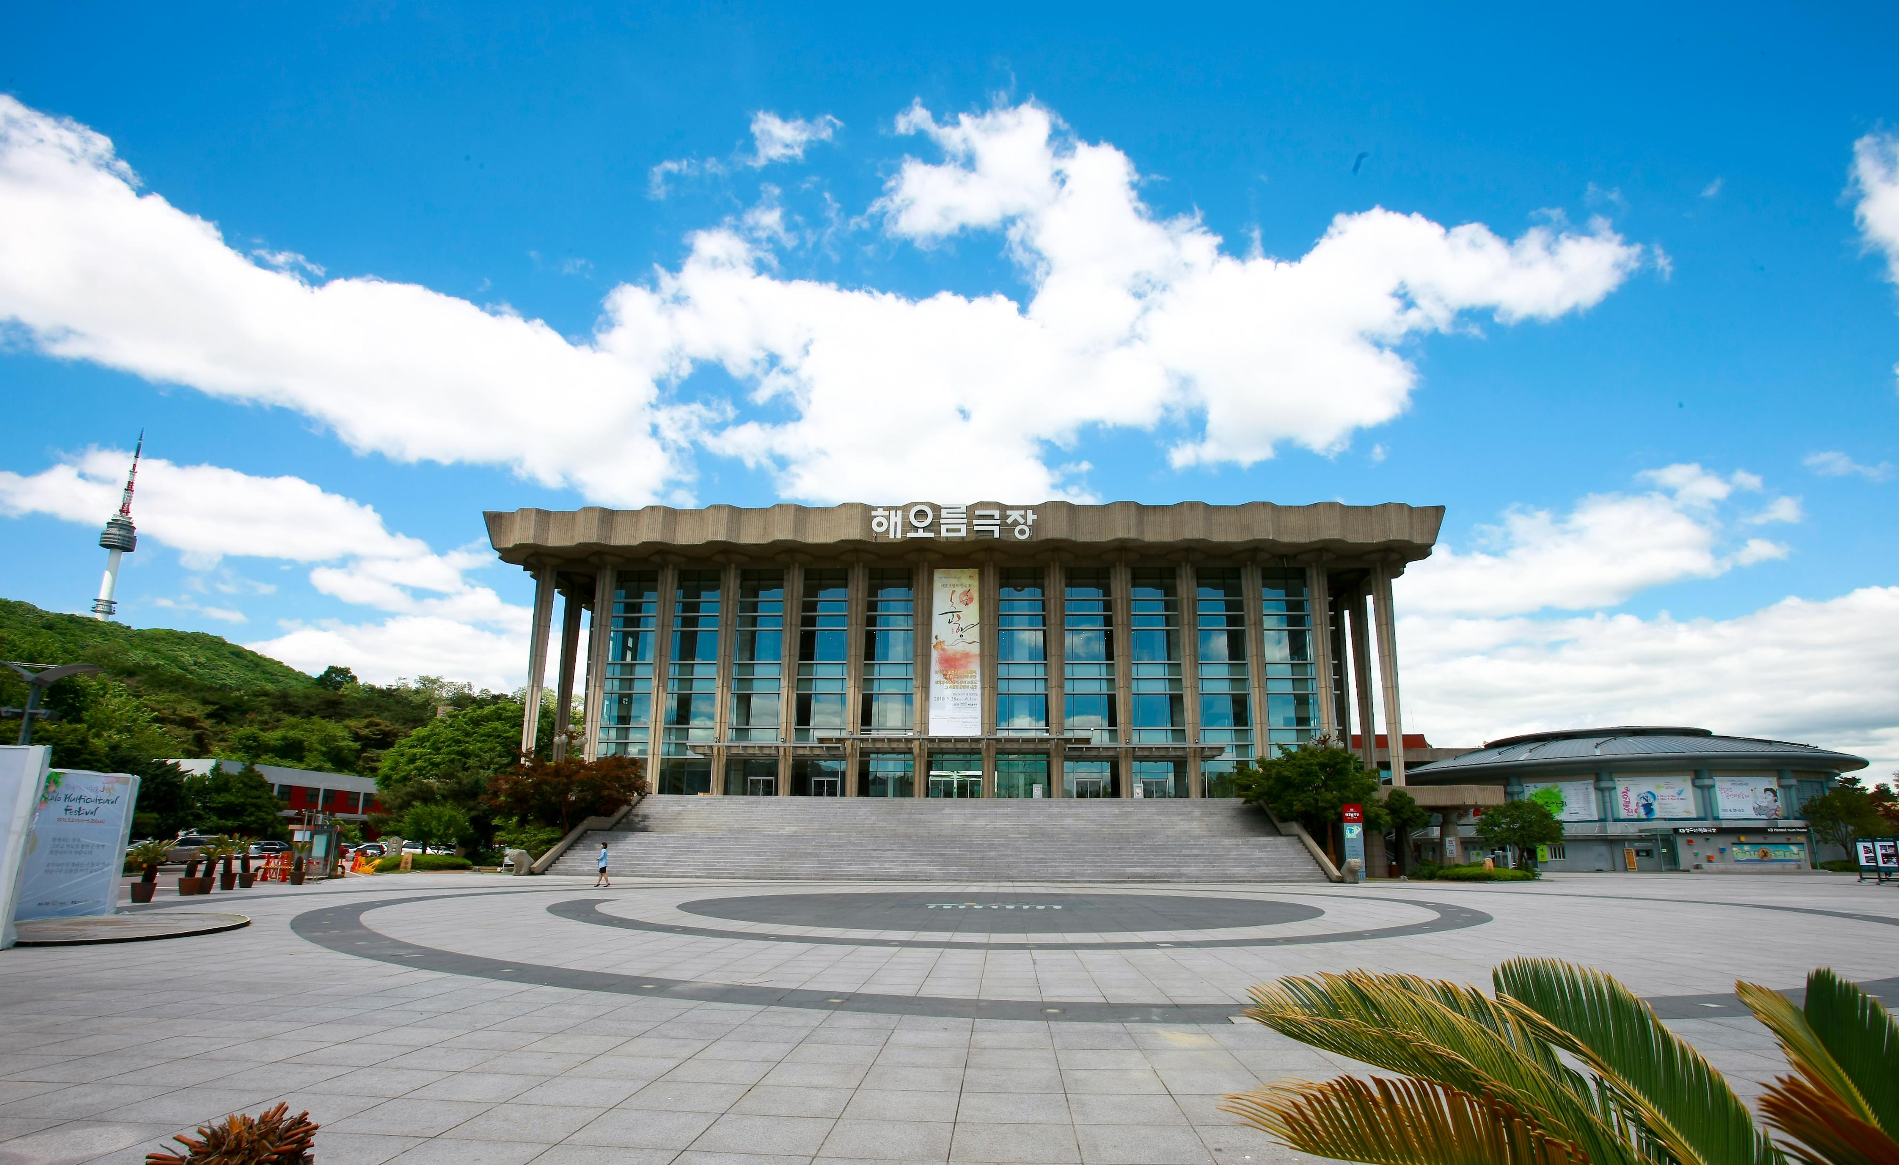
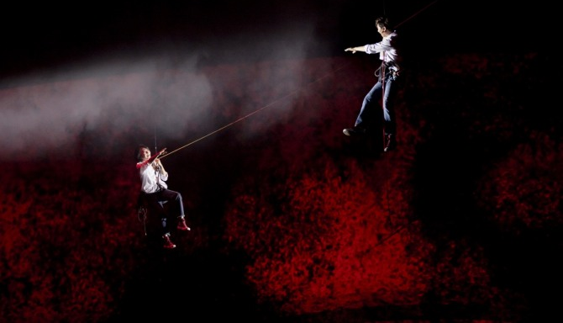
국립극장
Notes:
This is the National Theatre of Korea.
You don’t have to set foot on the peninsula to enjoy K-Theatre. There is a new musical headed to Broadway in 2022 called: K-Pop, composed by my musical writing colleague, Helen Park.

Slide 14
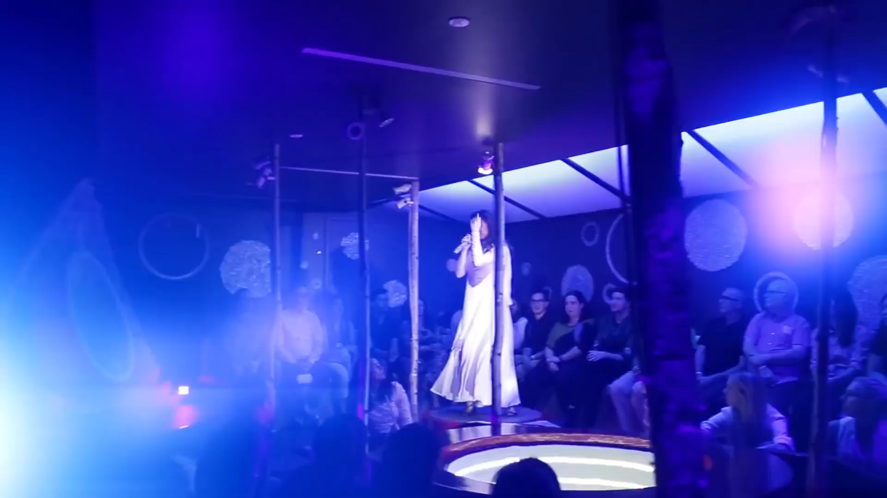
Notes:
You don’t have to set foot on the peninsula to enjoy K-Theatre. There is a new musical headed to Broadway called: K-Pop, composed by my musical writing colleague, Helen Park.

Slide 15
SEOUL-Y KOREAN & SOLELY AMERICAN
South Korea
Development starts in Seoul
United States
Development may start regionally
Typical run: 2-3 months
Irregular runs
Commercial industry is relatively new (50s); theatregoers are younger
Commercial industry is pioneered here (1920s); theatregoers are older
Agencies, Guilds, Unions
Agencies
“You’re just thrown out in the wilderness. You have to find your own way to survive here.”
“We like to derive and do crazy stuff… We’re finding out own voice and our own style.”
“The way they make musicals in the West is a little more... simple and rigid… by the book.”
Notes:
There are major differences between the Korean and American commercial industry. Broadway, Off-Broadway, Off-Off-Broadway pioneered the industry in the 1920s. Daehangno and the National Theatre of Korea started in the 1950s following the war. The audience is based on that. Soovin, who has experienced Broadway theatres, states: “We like to derive and do crazy stuff… We’re finding our own voice and our own style.” And there are many paths in the states while almost all workshops start in Seoul. And South Korea does not have unions like Actors' Equity or SAG-AFTRA.
To conclude this hot topic, I asked the coolest artist in the industry of any advice she would give to an up-and-coming producer.

Slide 16
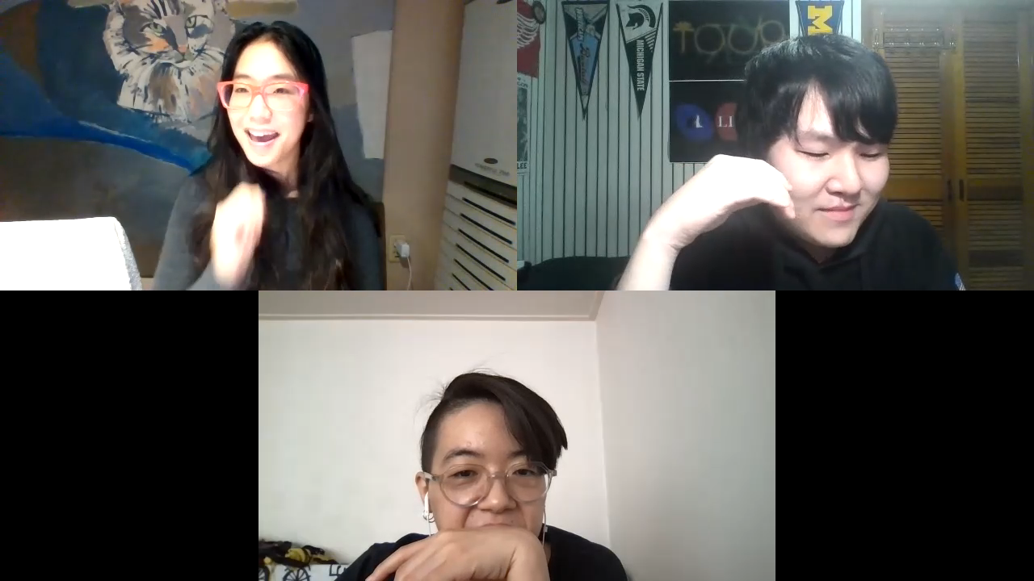

Slide 17
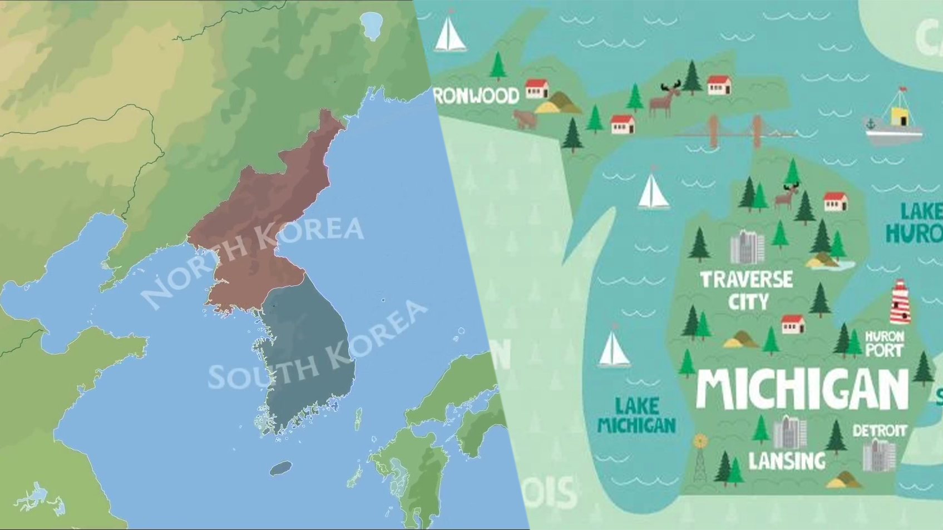
감사합니다
THANK YOU
Notes:
gam sa mi da

